Slide 1

Quiz time!

Slide 2
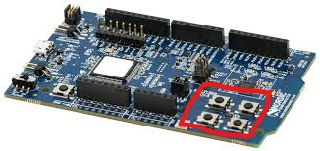
How to answer the questions
Download and compile the project named kahoot/kahoot_p and flash it onto your nRF52840DK using VS Code
Use the buttons in your DK to choose the right answer

Slide 3
Let the quiz begin!
Button 1
Button 2
Button 3
Button 4

Slide 4
Let the quiz begin!
Button 1
Button 2
Button 3
Button 4

Slide 5
Q1: How many employees does Nordic have?
500
1400
1000
486

Slide 6
Q1: How many employees does Nordic have?
500
1400
1000
486

Slide 7
Q2: Which one of these is a standard BLE GATT service?
Light service
Microphone service
Heart Rate Service
Accelerometer service

Slide 8
Q2: Which one of these is a standard BLE GATT service?
Light service
Microphone service
Heart Rate Service
Accelerometer service

Slide 9
Q3: Which of these channels are use for advertisement?
37,38,39
0,1,2
35,36,39
12,29,37

Slide 10
Q3: Which of these channels are use for advertisement?
37,38,39
0,1,2
35,36,39
12,29,37

Slide 11
Q4: What does CCCD stands for?
Cat Crypto Currency Deficit
Client Characteristic Configuration Descriptor
Client Characteristic
Configuration Data
Client Controller Configuration Disk

Slide 12
Q4: What does CCCD stands for?
Cat Crypto Currency Deficit
Client Characteristic Configuration Descriptor
Client Characteristic
Configuration Data
Client Controller Configuration Disk

Slide 13
Q5: What frequency does BLE use?
900MHz
9000MHz
2.4MHz
2.4GHz

Slide 14
Q5: What frequency does BLE use?
900MHz
9000MHz
2.4MHz
2.4GHz

Slide 15
Q6: Which of these peripherals are restricted when using the Softdevice Controller?
Temperature sensor
SPI
Accelerometer
ADC

Slide 16
Q6: Which of these peripherals are restricted when using the Softdevice Controller?
Temperature sensor
SPI
Accelerometer
ADC

Slide 17
Q7: Which of these protocols are NOT supported by Nordic?
Zigbee
Bluetooth Classic
Thread
ANT

Slide 18
Q7: Which of these protocols are NOT supported by Nordic?
Zigbee
Bluetooth Classic
Thread
ANT

Slide 19
Q8: How much internal flash do we have in the nRF52840?
64kB
512MB
1024kB
512kB

Slide 20
Q8: How much internal flash do we have in the nRF52840?
64kB
512MB
1024kB
512kB

Slide 21
Q9: How many bytes of payload can you have in a single BLE advertisement packet* ?
32 bytes
31 bytes
16 bytes
27 bytes
*without advertisement extension

Slide 22
Q9: How many bytes of payload can you have in a single BLE advertisement packet* ?
32 bytes
31 bytes
16 bytes
27 bytes
*without advertisement extension

Slide 23
Q10: How many chips do Nordic Semiconductor sell each day on average?
1.000.000
100.000
10.000.000
500.000

Slide 24
Q10: How many chips do Nordic Semiconductor sell each day on average?
1.000.000
100.000
10.000.000
500.000

Slide 25
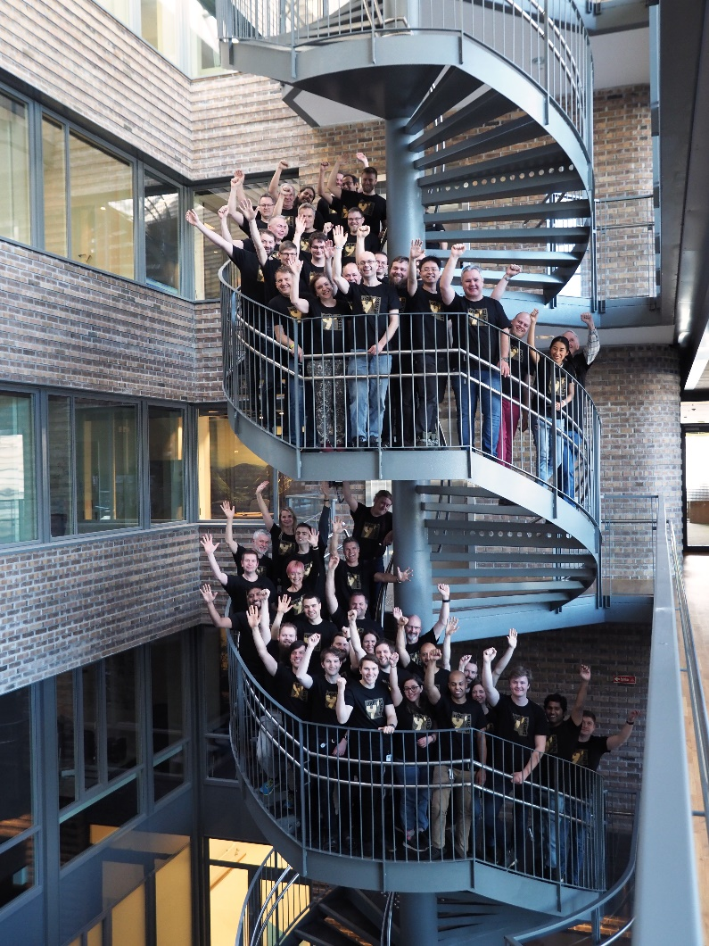
Career?
https://www.nordicsemi.com/Career

